Slide 1
seCURE DATA HIDING IN IMAGES USING STEGANOGRAPHY
CAPSTONE PROJECT
Presented By:
Student Name : Mohd Ayaan
College Name & Department : Indian Institute of Information Technology(IIIT) Ranchi, Computer Science & Engineering

Slide 2
OUTLINE
Problem Statement
Technology used
Wow factor
End users
Result
Conclusion
Git-hub Link
Future scope

Slide 3
Problem Statement
The surge in digital communication has amplified the demand for secure data transmission. Conventional encryption techniques, while effective, can attract unwanted scrutiny, making covert data concealment essential. This project leverages image steganography to seamlessly embed confidential messages within images, ensuring both secrecy and discretion. By encoding the message into pixel values and enabling retrieval through a passcode, this approach significantly enhances security while maintaining the integrity of the original image.

Slide 4
Technology used
Programming Language: Python
Libraries Used:
1. OpenCV (cv2): For efficient image processing
2. OS: For seamless file handling and system operations
3.String: For character mapping and text manipulation
4.Streamlit: For an intuitive user interface and effortless deployment
Platform: Windows (Easily adaptable for other operating systems with minor modifications)
Encryption Method: Secure pixel-based data embedding within images, ensuring discreet and
tamper-resistant communication
Decryption: Passcode-protected extraction of hidden messages, granting access only to authorized
users for enhanced security

Slide 5
Wow factors
Stealthy Data Hiding: Unlike traditional encryption, which can raise suspicion, this method seamlessly conceals
data within images, making it virtually undetectable.
Passcode Protection: Ensures that only authorized users can access the hidden message, adding an extra layer
of security against unauthorized decryption.
Lightweight & High-Speed Processing: Utilizes efficient pixel manipulation techniques, enabling rapid encoding
and decoding without significant computational overhead.
Storage-Efficient: Eliminates the need for separate encrypted files by embedding the message directly within the
image, optimizing space usage.
Enhanced Security with Custom Character Mapping: Implements a unique character-to-pixel mapping technique,
increasing the complexity of data retrieval and reinforcing security.

Slide 6
End users
Journalists & Activists: Safely communicate sensitive information while bypassing surveillance and censorship,
ensuring anonymity and security.
Government & Defense: Facilitate covert intelligence operations by embedding classified data within images,
reducing the risk of interception.
Corporate Sector: Protect proprietary information, trade secrets, and confidential business data from cyber threats
and industrial espionage.
General Users: Share private messages discreetly by embedding them within digital images, preventing
unauthorized access and detection.
Cyber Security Professionals: Explore and implement advanced steganography techniques to enhance secure
data transmission and counteract cyber threats.

Slide 7
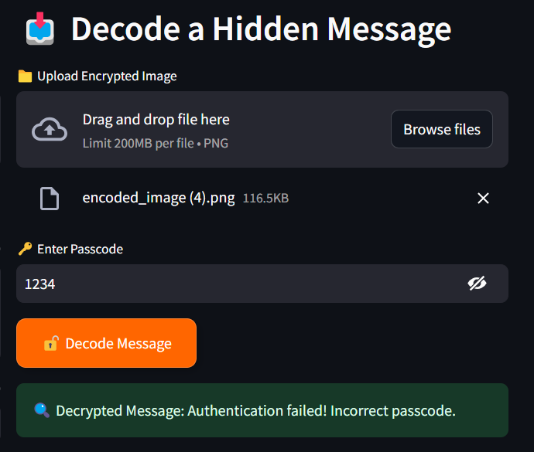
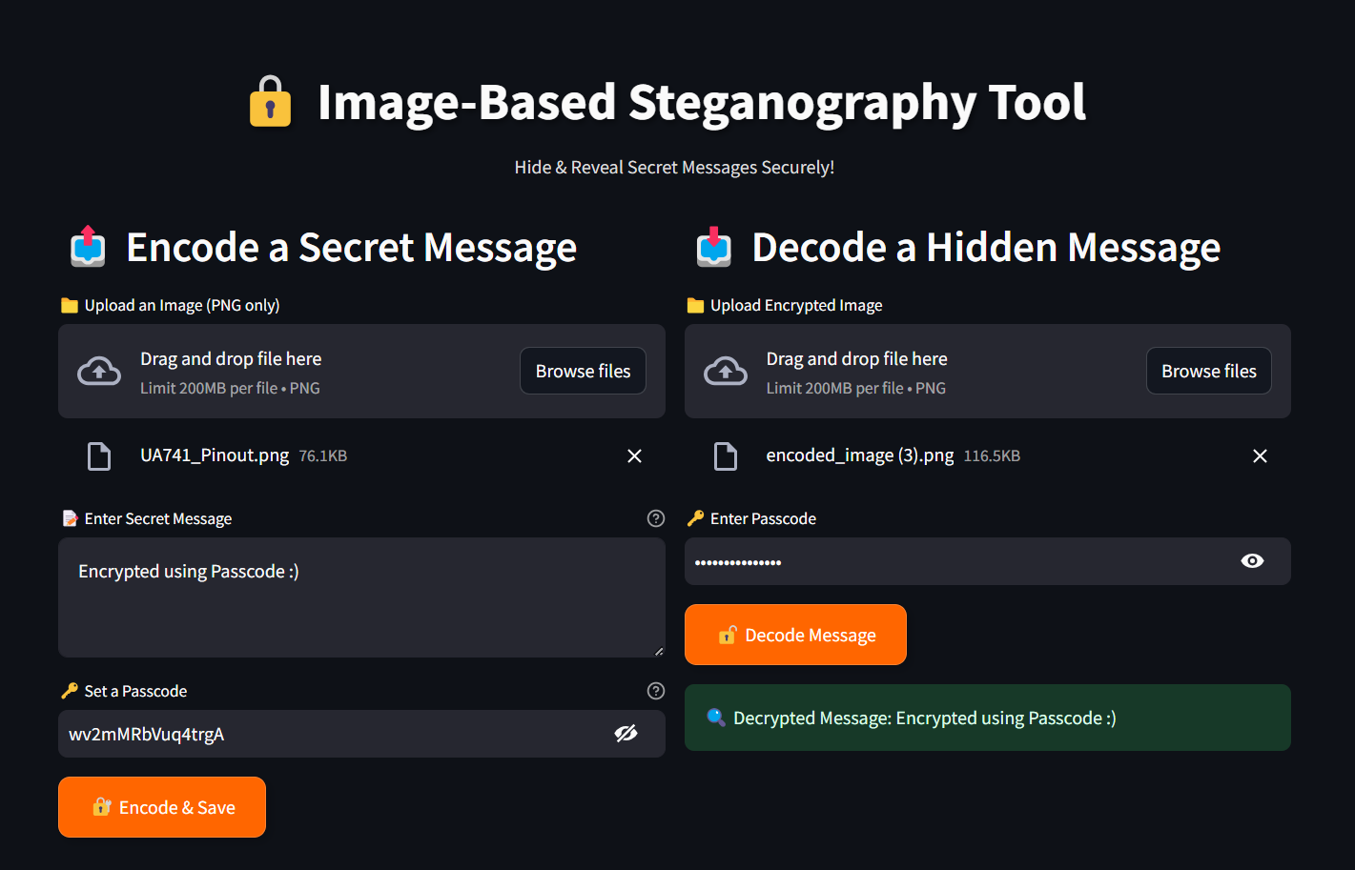
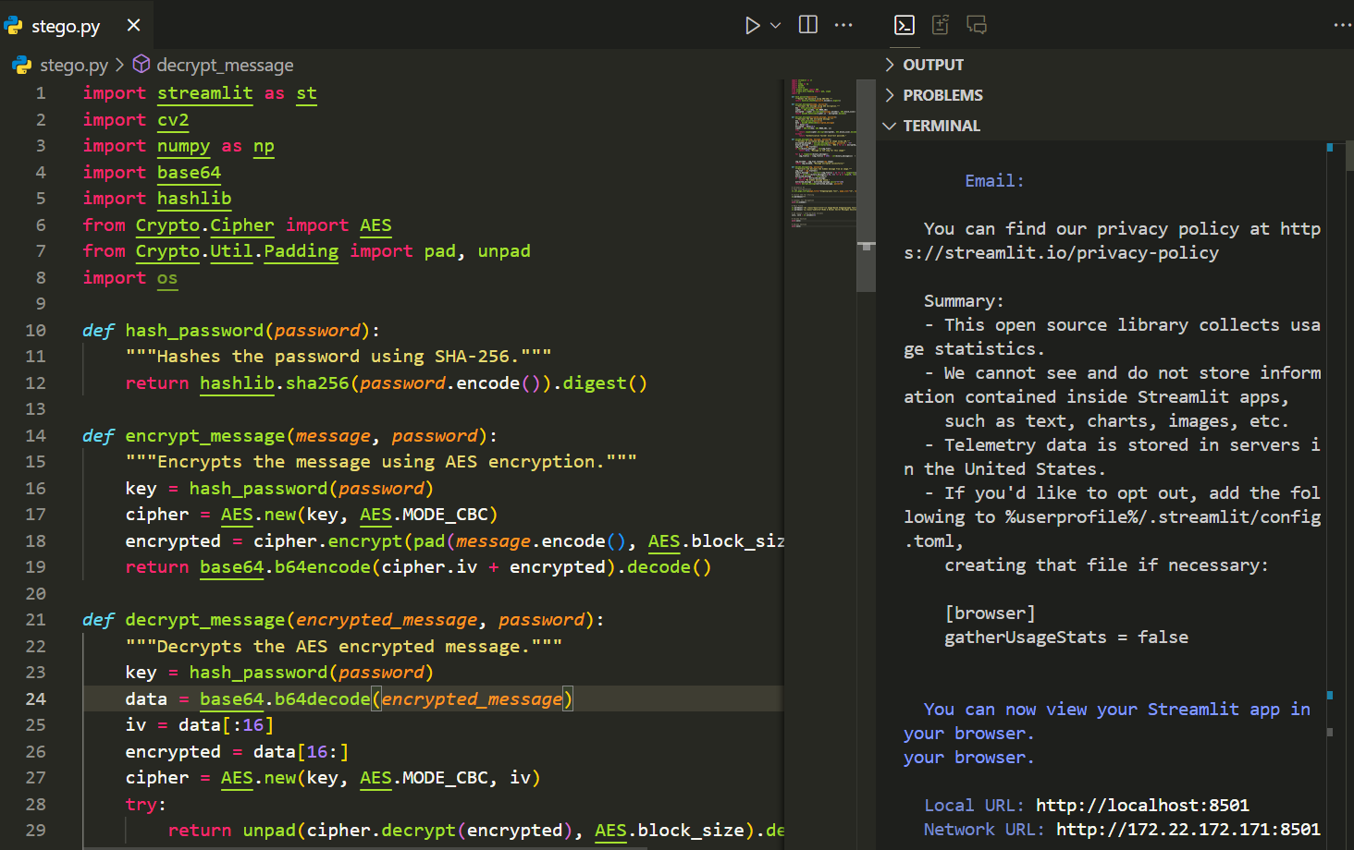
Results
Authentication failed
Error on wrong passcode =>
Deployed on Streamlit
Code =>

Slide 8
Conclusion
This project effectively meets the growing demand for secure and discreet data transmission by utilizing advanced image steganography. Unlike conventional encryption, which can draw unwanted attention, this technique seamlessly embeds messages within images, rendering them virtually undetectable. The integration of passcode protection further strengthens security, ensuring that only authorized users can access the concealed data. With its lightweight design, high efficiency, and versatility, this approach offers a robust and practical solution for confidential communication across diverse domains, including journalism, cybersecurity, defense, and corporate sectors.

Slide 9
GitHub Link
GitHub Link: https://github.com/mohdayaan786/Image-Steganography
Live Link: https://image-steganography-dpsumkga9sdypyvg27lqny.streamlit.app/

Slide 10
Future scope(optional)
Advanced Security Integration: Strengthen data protection by combining robust encryption techniques with
steganography, ensuring an extra layer of defense against unauthorized access.
Optimized Data Embedding: Enhance algorithms to maximize storage capacity, enabling larger data concealment
while preserving image quality and visual integrity.
Multi-Layer Steganography: Implement a multi-tiered approach to hide data within different layers of an image,
significantly increasing resistance to detection and extraction attempts.
Seamless Cross-Platform Accessibility: Develop an intuitive GUI and mobile application for effortless usage across
various devices and operating systems, improving accessibility and user experience.
AI-Driven Detection Evasion: Leverage machine learning models to counter steganalysis techniques, proactively
adapting to evolving security threats and preventing unauthorized detection.

Slide 11
THANK YOU

